Slide 1
Working with JSON

Slide 2
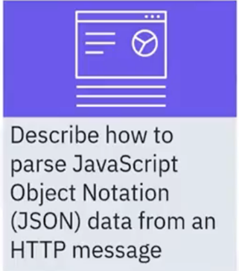
What you will learn

Slide 3
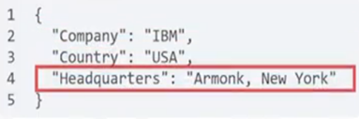
Parse JSON data from HTTP message
• JSON is the standard format for application programming
interface (API) data exchange
• Because it is the standard representation of native
JavaScript objects, Node.js handles JSON easily

Slide 4
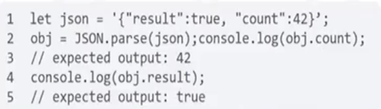
Parse JSON data from HTTP message
• Method JSON.parse() parses a JSON string to a JavaScript
object

Slide 5

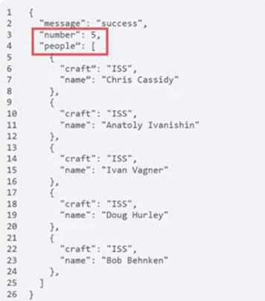
Example: How many astronauts?
• The number of astronauts is five
• This is an example of using a real end point
that returns JSON
Astronauts in the ISS

Slide 6
Recap
In this video, you learned that:
• Node.js handles JSON easily
• You can use two important methods to parse a string into JSON
and also convert JSON into a string

